Slide 1
System Engineers’ Workshop
December 11, 2020
Presented By:
J. Ted Orrell, PE, President

Slide 2
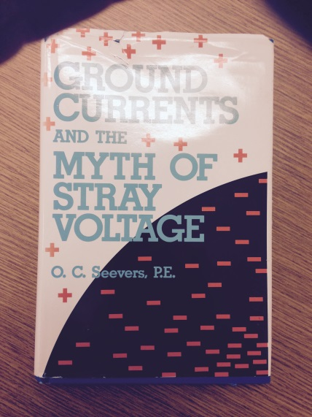
What is “Stray Voltage”?
A very good reference on the subject is:
“Ground Currents and the Myth of Stray Voltage” by O. C. Seevers, P.E.
NC Electric Cooperatives

Slide 3
What is “Stray Voltage”?
Mr. Seevers’ book focuses on stray voltages in dairy farms, but the principles addressed apply to any stray voltage situation.
Mr. Seevers makes several important comments and observations:
Stray voltage is “voltage which appeared where it had no business being”.
“There is no such thing as stray voltage! Voltage does not “stray”. Voltage does not go anywhere. It exists at a location as electrical pressure between two points, A and B.”
“Nowhere in any of the horror tales which I have studied dealing with “stray voltage” have I seen that anyone looked at the distribution system and analyzed how it works. How primary neutral current returns to its source.”
NC Electric Cooperatives

Slide 4
What Causes Stray Voltage?
Simply stated, stray voltage is caused by current flowing in the earth.
Possible Reasons for Stray Voltage:
Faulty cable or equipment (Figure 1)
High impedance fault to ground
Resulting in low levels of ground fault current
Voltage of equipment frame, metal buildings, etc. in the fault path rises relative to remote earth - Neutral-to-Earth Voltage (NEV) *
NC Electric Cooperatives

Slide 5
What Causes Stray Voltage?
Transferred Potential *(Figure 2)
The voltage, or potential, of a point in an electrical system neutral is transferred to another point where the voltage is less
Fundamental 60 Hz
3rd Harmonic 180 Hz
Other Harmonic currents
*The typical cause of stray voltage is transferred voltage resulting from neutral/earth current flow
NC Electric Cooperatives

Slide 6
What Causes Stray Voltage?
High Resistance or Open Point in Utility Primary Neutral Conductor (Figure 3)
NC Electric Cooperatives

Slide 7
What Causes Stray Voltage?
Ground Current From Outside Sources (Figure 4)
NC Electric Cooperatives

Slide 8
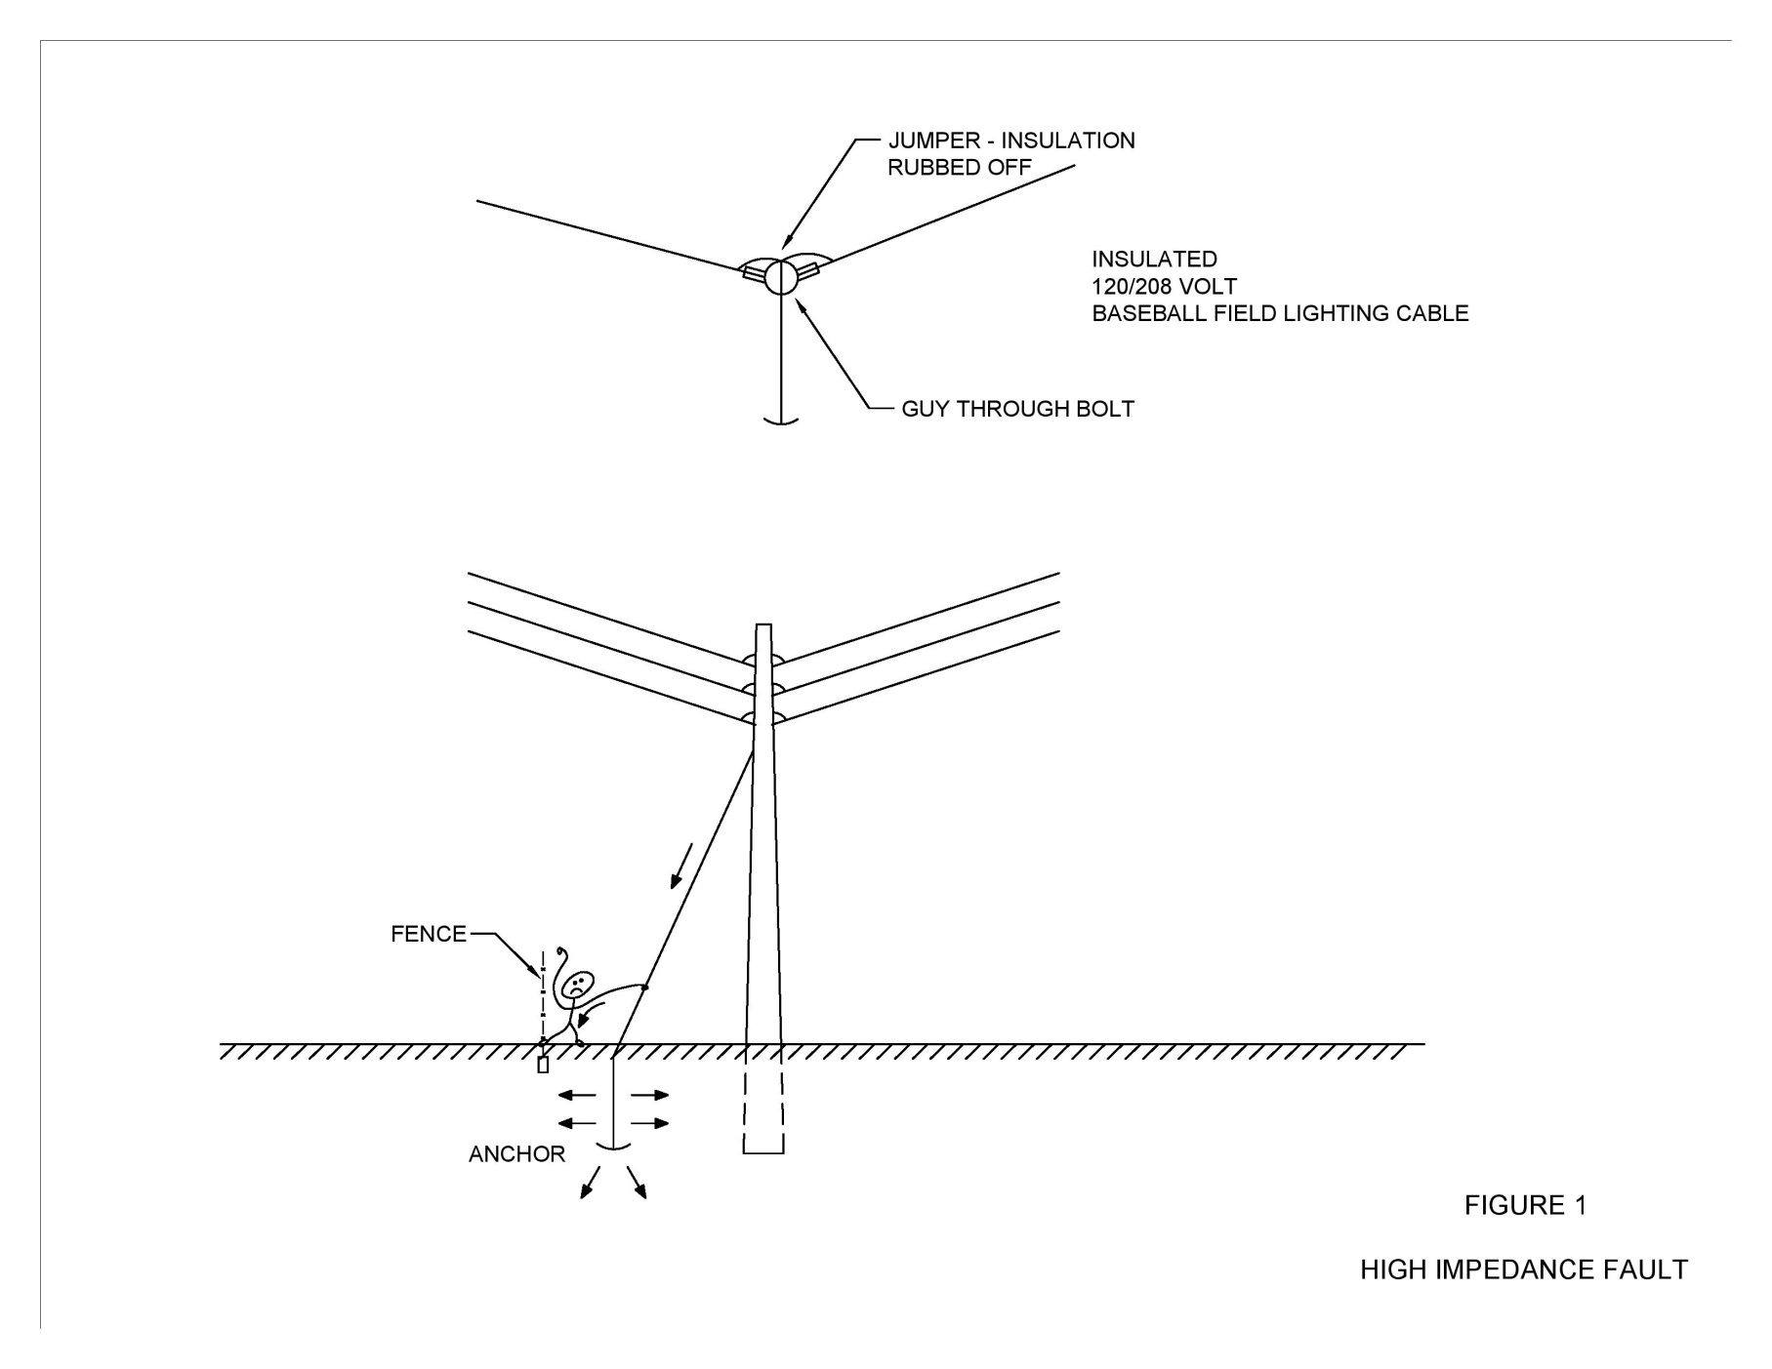
Figure 1 – High Impedance Fault
NC Electric Cooperatives

Slide 9
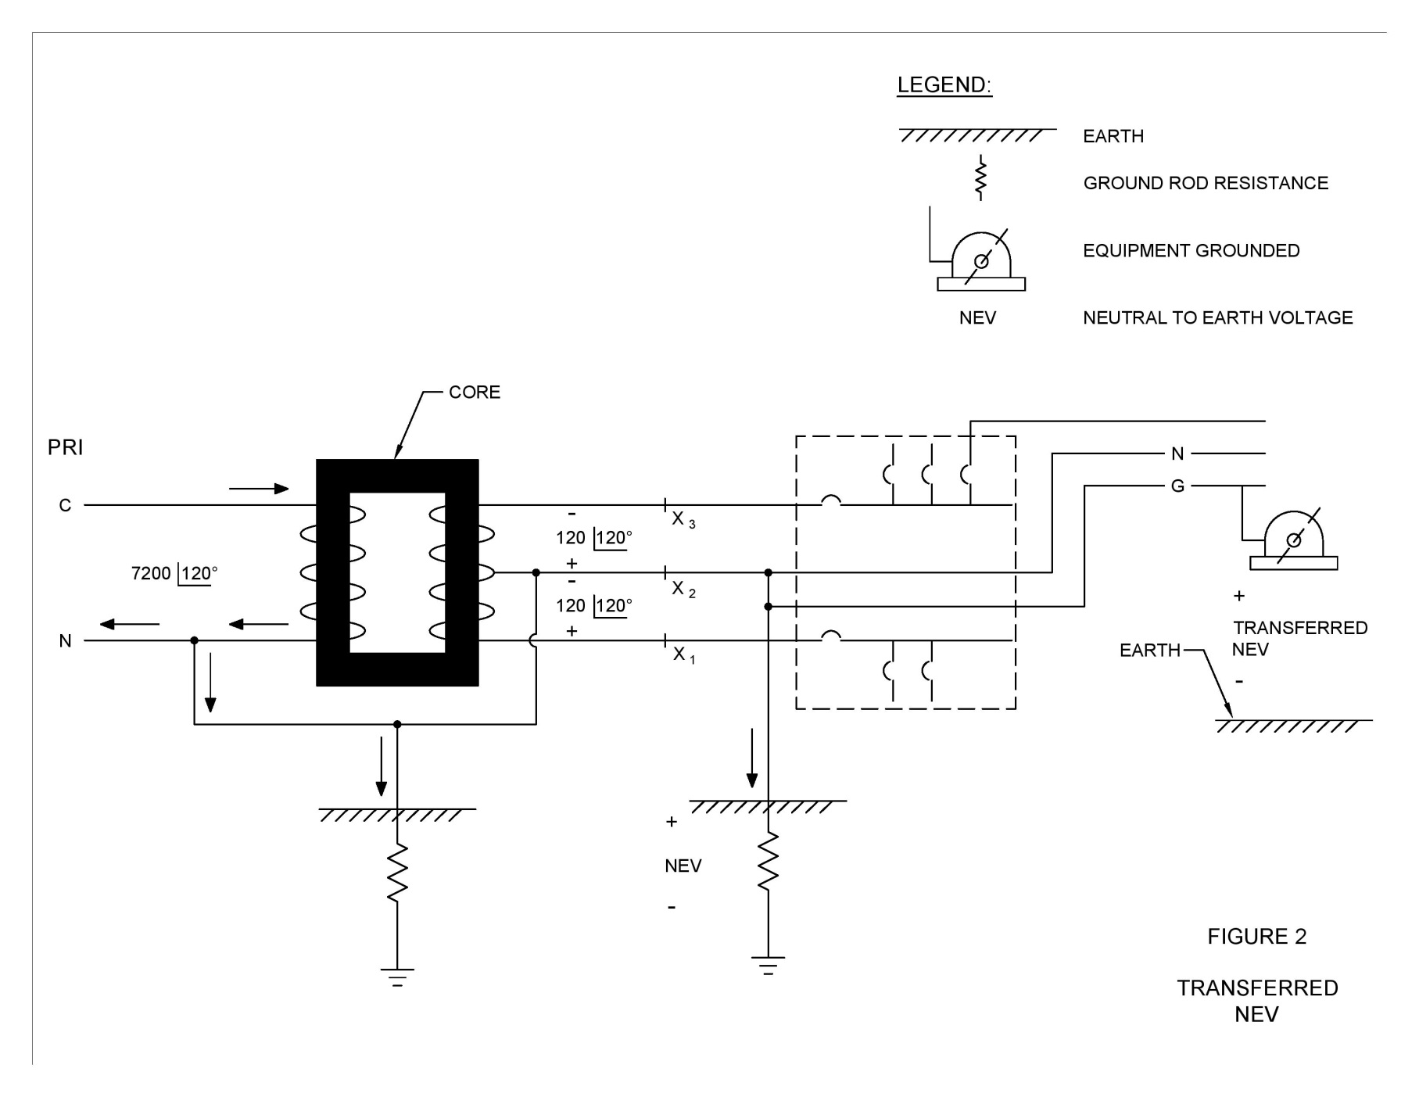
Figure 2 – Transferred Potential
NC Electric Cooperatives

Slide 10
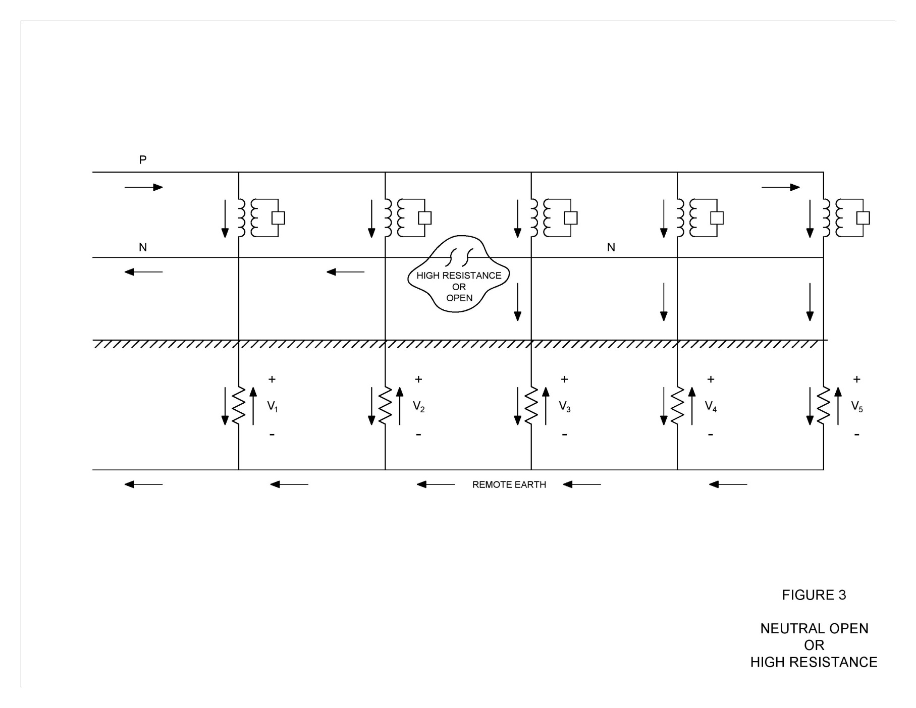
Figure 3 – Neutral Open or High Resistance
NC Electric Cooperatives

Slide 11
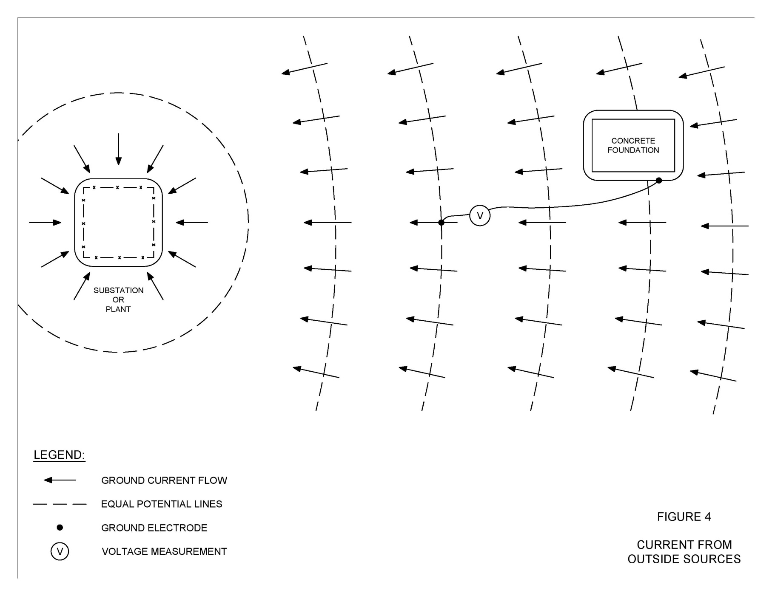
Figure 4 – Current From Outside Sources
NC Electric Cooperatives

Slide 12
Soil Resistivity
A parameter that affects Ground Electrode (Ground Rod) Resistance and NEV is Soil Resistivity
Soil Resistivity
Soil Resistivity indicates the conductivity of the soil within a project vicinity
Soil Resistivity is required to calculate the impedance of the neutral conductors with ground return and ground rod resistance
Soil Resistivity can be determined from soil resistivity tests on site
OR
Can be estimated from recorded data in the area of interest
NC Electric Cooperatives

Slide 13
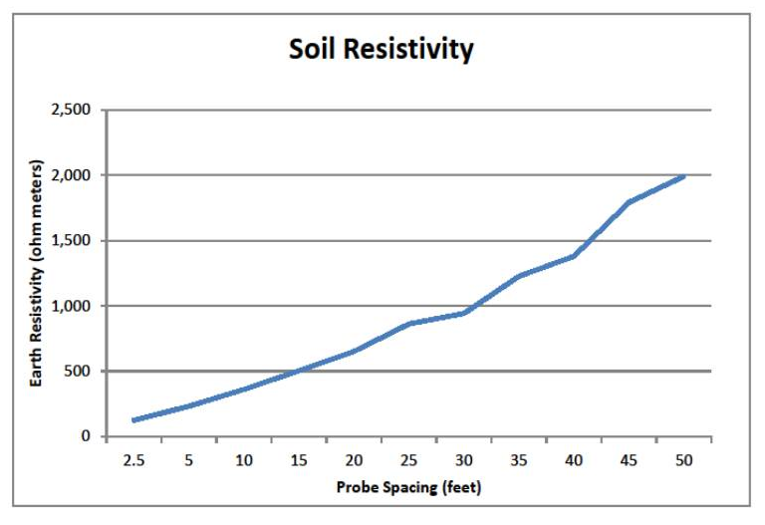
Field Measured Soil Resistivity - Rocky Quarry in NC
UTEC uses SAFE Engineering software to calculate equivalent multi-layer soil model
71.7 ohm-meters surface to depth of 2.5 feet
10,871 ohm-meters below 2.5 feet
NC Electric Cooperatives

Slide 14
Neutral Line Section Impedance
Classic “Carson” equation used to calculate impedance of overhead conductor with ground return:
Z11 = (Re + R1) + j (Xe + X1), where:
Re = 0.00159 f, where f is the frequency in hertz, (earth resistance)
R1 = conductor resistance in ohms/mile
Xe = 0.002328 * f *(log₁₀ 4,665,600 ρ /f), where ρ =soil resistivity in ohm-meters, (earth return path reactance)
X1 = conductor inductive reactance in ohms/mile for one-foot spacing
NC Electric Cooperatives

Slide 15
Ground Rod Resistance
The equation for the resistance of a single ground rod is:
R = ρ/(2*π*L) * [ln(COT(Ɵ/2)], where:
ρ is the homogeneous soil resistivity in units of ohm-meters
L is the ground rod length in meters (For example, 2-5/8” X 8’ rods connected to make a 16’ rod, 4.877 meters)
Ɵ is the angle formed between the axis of the ground rod and a point of interest on the earth surface
COT is cotangent of Ɵ/2
Ln is the natural log of the value COT(Ɵ/2)
Mathematically, the full resistance of a ground rod is calculated at a distance infinitely away where Ɵ/2=45 degrees
NC Electric Cooperatives

Slide 16
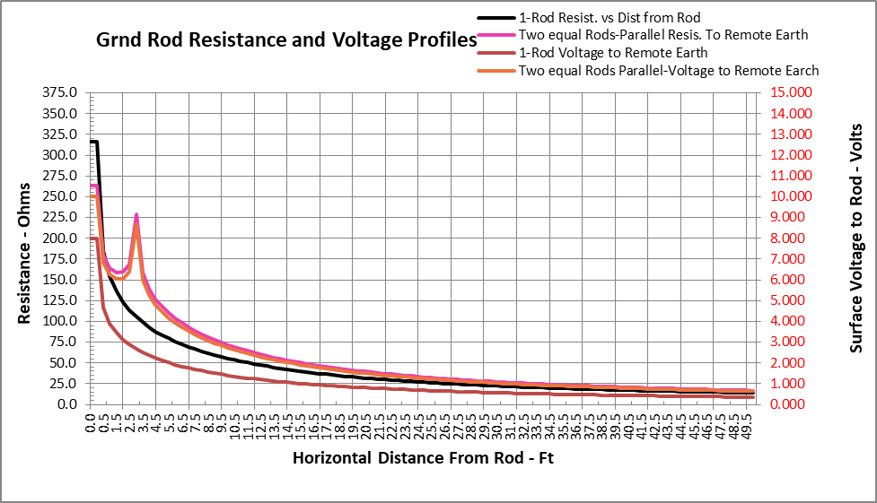
Chart of Ground Rod Resistance versus Distance from Rod For: 1 – ¾” x 10’ Copperweld Ground Rod Then: 2 – Parallel Ground Rods Installed 3’ Apart
Soil Resistivity is 1361 ohm-meters
1 – Rod Resistance is 316 ohms
2 – Rods Separated 3’ Resistance is 211 ohms
2 – Rod separated 30’ Resistance is 169 ohms
NC Electric Cooperatives

Slide 17
Is Stray Voltage a Problem?
At a minimum, stray voltage can be annoying.
At a maximum, stray voltage can be lethal.
Examples of Stray Voltage
Shock when in a swimming pool and touching the metal ladder to get out of the pool
Shock when touching a pole down guy wire
Shock to cattle when attached to a milking machine or feeding
Shock when touching grounded equipment in a rock quarry
NC Electric Cooperatives

Slide 18
Neutral-Earth-Voltage (NEV) Analysis
Example Typical 1-PH System (Figure 5)
NC Electric Cooperatives

Slide 19
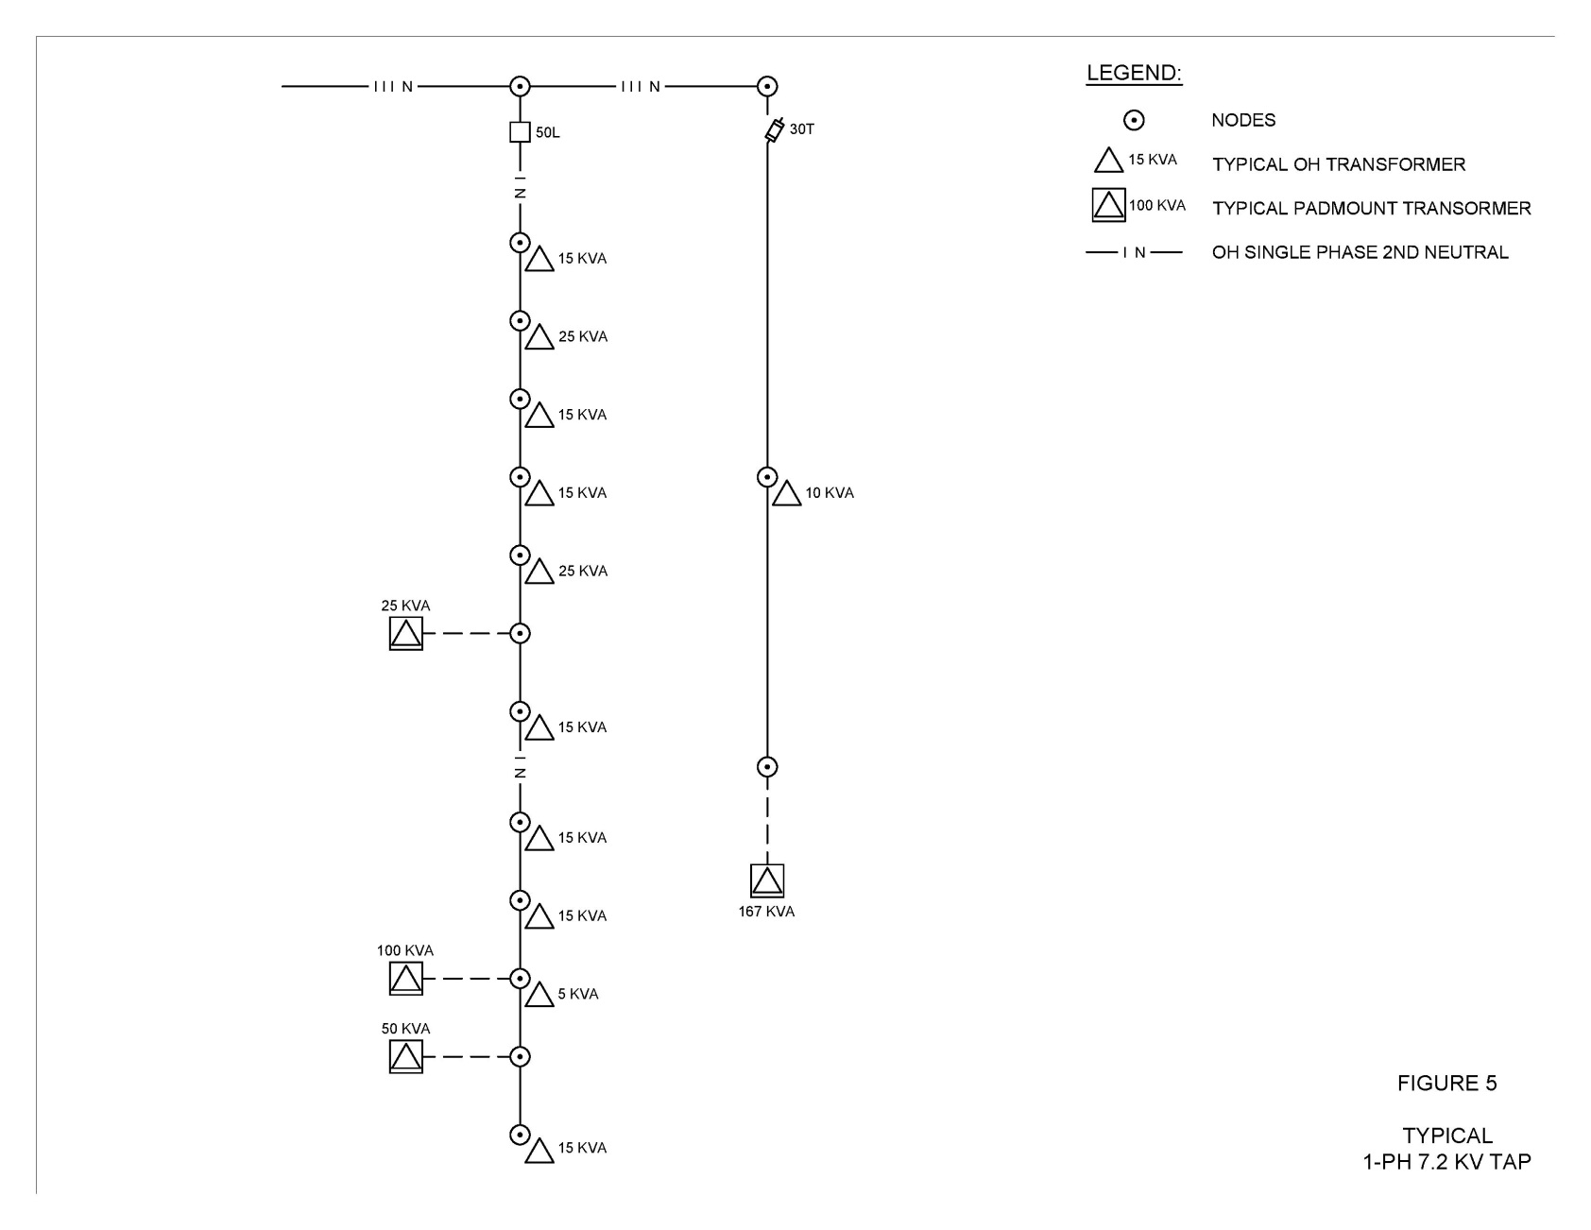
Figure 5 – Typical 1-PH 7.2 kV TAP
NC Electric Cooperatives

Slide 20
Neutral-Earth-Voltage (NEV) Analysis
1-PH System Nodal Circuit Model (Figure 6)
Twenty-One Nodes
Current Sources – Transformer Neutral Connections
Admittance Matrix Elements
Neutral Conductor Sections
Ground Electrodes
All Matrix Elements have both Real and Imaginary Components
Admittance Matrix is 42 rows x 42 columns
The “Unknowns” to be solved for are Node Voltages and Element Currents
NC Electric Cooperatives

Slide 21
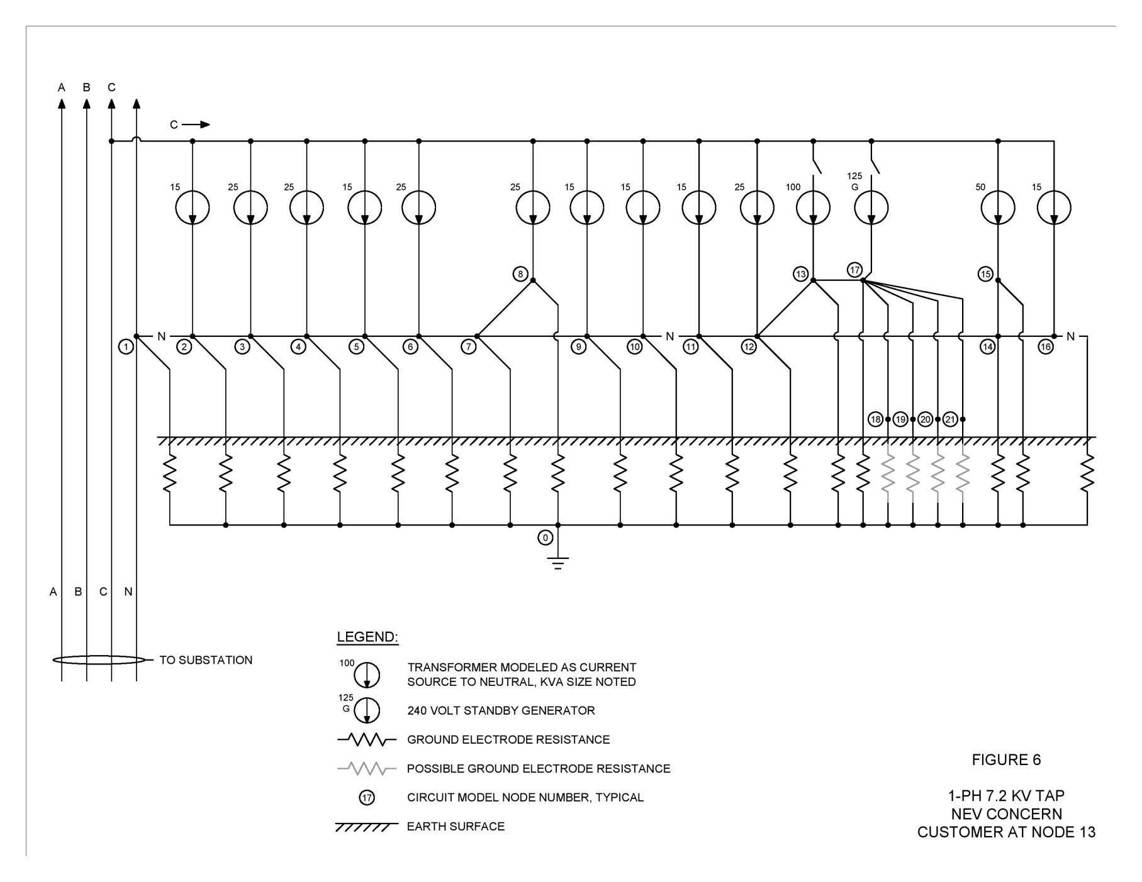
Figure 6 – 1-PH 7.2 kV TAP NEV CONCERN CUSTOMER AT NODE 13
NC Electric Cooperatives

Slide 22
Nodal Matrix Solution
1-Phase Circuit (Figure 6)

Slide 23
Nodal Matrix Solution
1-Phase Circuit (Figure 6)

Slide 24
Analysis Findings
The current flowing into the neutral/ground system is a constant and is not changed by increasing neutral conductor size or adding ground rods
Modifying the neutral conductor size, adding ground rods, or modifying ground rod resistance will change current flow in the neutral/ground system and therefore will modify NEV
Adding ground rods at the problem point will reduce ground rod resistance which will increase ground current into that point, and may increase NEV
NC Electric Cooperatives

Slide 25
Analysis Findings
Voltage blocking devices are commercially available that will electrically separate the utility neutral from the customer service ground
Electrically separating the utility neutral from the customer service ground can significantly reduce customer NEV
When using neutral voltage blocking devices, the customer service ground must be separated from the utility ground rod by more than 10 feet
For three-phase circuits, balancing load among phases will minimize neutral/ground current NEV
NC Electric Cooperatives

Slide 26
QUESTIONS & DISCUSSION December 2020
J. Ted Orrell, PE, president
jtorrell@utilitytec.com
Utility Technology
Engineers-Consultants PLLC

